Slide 1
Midterm Project Proposal
By Stella Liu

Slide 2

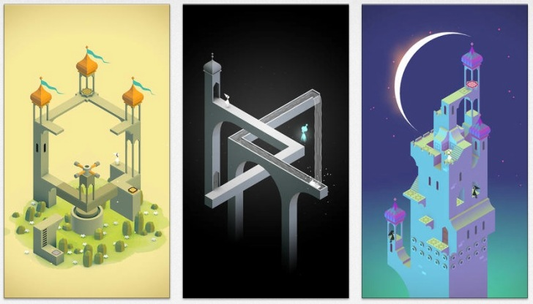
Theme
Monument Valley
Optical Illusion
Interaction?
Why I think it is one of the best puzzle game?
Small experience of the changing cube

Slide 3
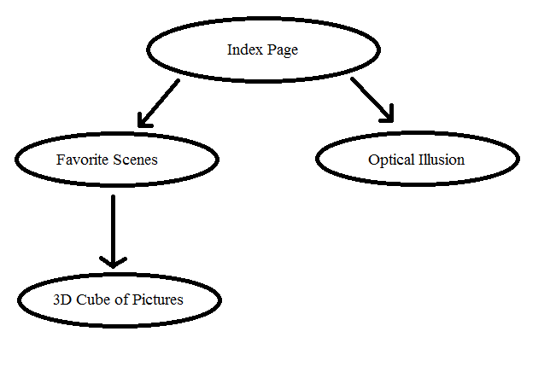

Slide 4
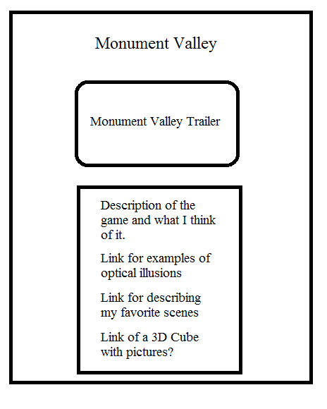

Slide 5
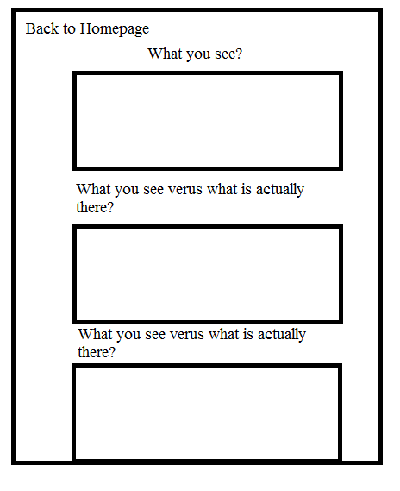

Slide 6
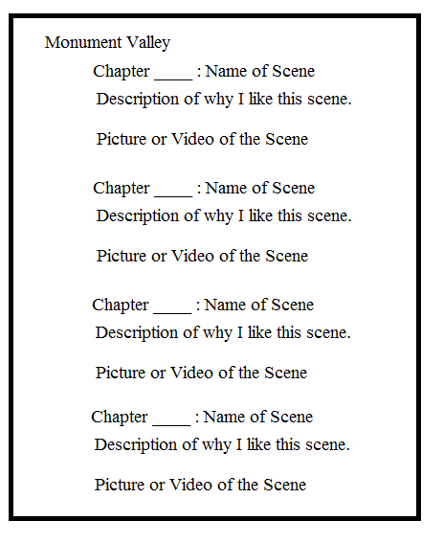

Slide 7
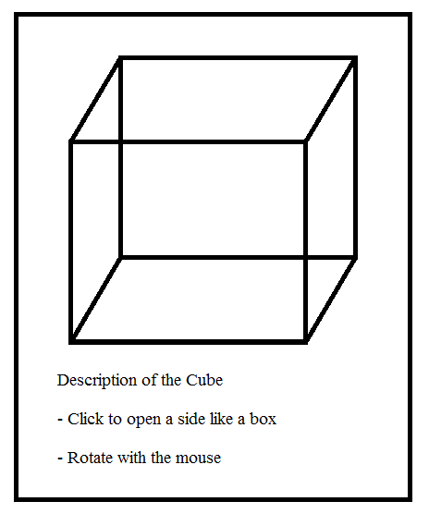

Slide 8
Skills
Learned
Linking Pictures
Listing
Changing Background
Organizing my sections
Need to Learn
Linking Videos
Rotating and Translating Pictures
JavaScript to interact with the 3D Cube

